Slide 1
CSS Complex Properties
Tutorial #12

Slide 2
OBJECTIVE

Slide 3
Objective
At the end of this tutorial, you will have been introduced to the concept of CSS shorthand. More importantly, you will have seen some of the interesting nuances that are associated with coding in CSS.

Slide 4
TEXTPLANATION

Slide 5
Textplanation
CSS goes a lot deeper than just color and text alignment. When you start working with fonts and borders, you have to deal with a cornucopia of different properties that make up the whole shebang dang doodle.

Slide 6
Textplanation
Let’s talk about some fonts.

Slide 7
Textplanation
If I want to change my font to, say, comic sans ms (because everyone loves comic sans ms), you can do that. But what size is it? Is it bold or italic or normal? Do you want it underlined? Each of these different possible aspects of the text have their own CSS properties that go with them. In order to set the font itself, you use the font-family property. In order to set the size, you use font-size. For bold, you use font-weight, and for underline, you use text-decoration (bet you didn’t see that one coming).

Slide 8
Textplanation
As you may have guessed, setting up a font can get pretty involved. And setting up a font isn’t the only thing that’s built this way. In order to avoid whole lots of extra lines of code, CSS has something called shorthand. So, instead of setting the font-family and the font-size and the font-weight, you can use the font property and set all of those things at once.

Slide 9
Textplanation
Text-decoration, unfortunately, is not included with this package.

Slide 10
Textplanation
Before moving on to construction, I want to talk about font-size. There are a lot of CSS properties that require a measurement of some kind. Whenever you give a size a value, that value has to be more than just a number. If I say that my font-size is 12, the question on the browser’s mind is 12 what?

Slide 11
Textplanation
The most common measurement types for CSS are px for pixels, cm for centimeters, in for inches, and whatever that adjustable one is. There are other less common ones. Fonts can use any one of those, but most often use pt for point. When software measures a font, it’s usually in points.

Slide 12
CONSTRUCTION

Slide 13
Construction
Create a folder somewhere on your drive and label it CSS Complex Properties.
Open up notepad++.
Save the empty file to your folder and name the file “index.html”.
All first pages on a website are called index.
As you go through the images of the construction, add to your code. You will see comments with explanations of what you are doing. Those comments will change with each slide. You should not type my comments into your code.

Slide 14
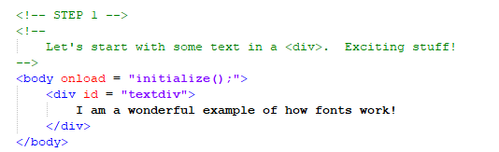
Construction

Slide 15
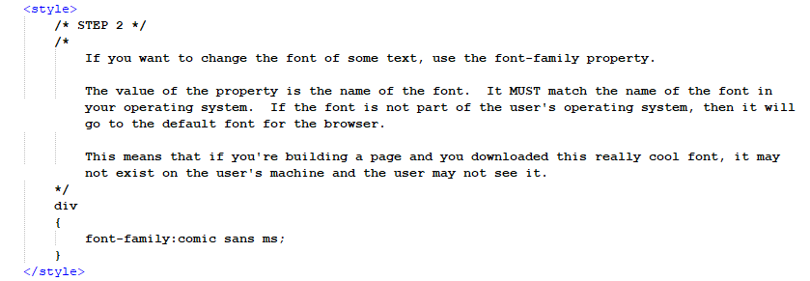
Construction

Slide 16
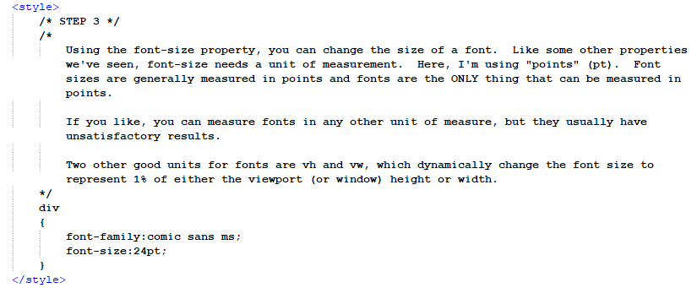
Construction

Slide 17
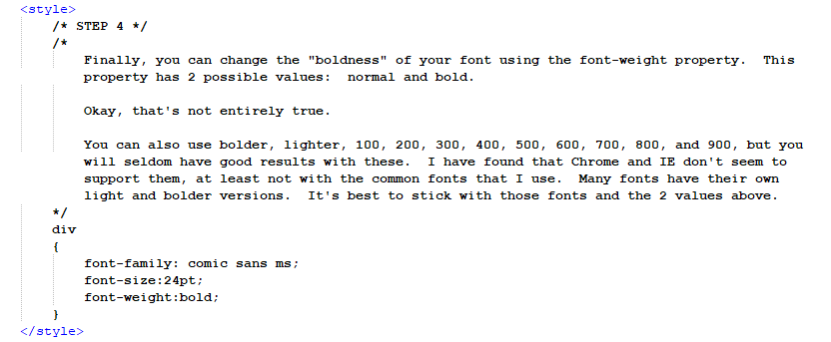
Construction

Slide 18
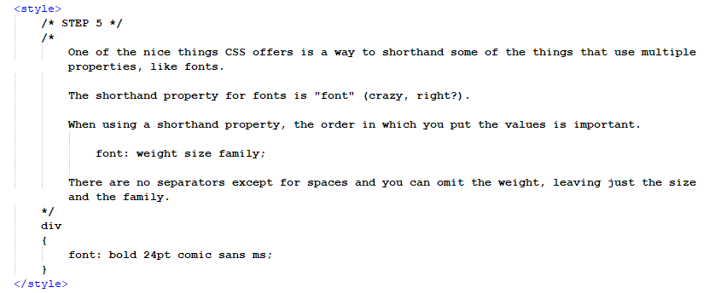
Construction

Slide 19
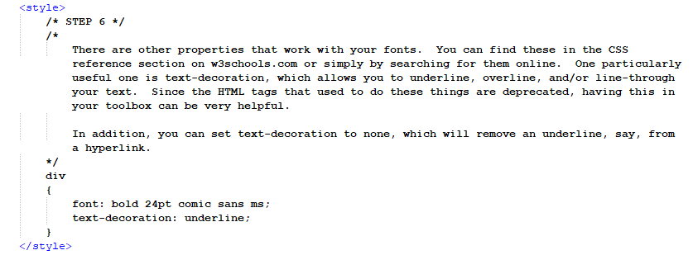
Construction

Slide 20
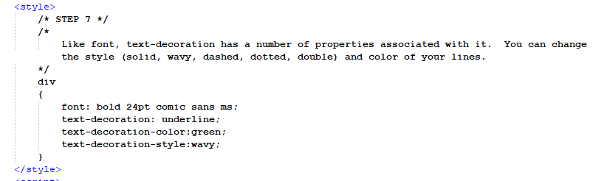
Construction

Slide 21
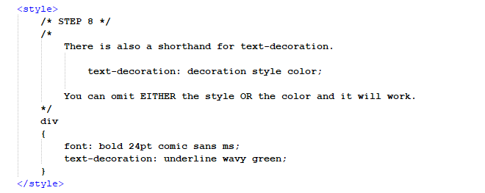
Construction

Slide 22
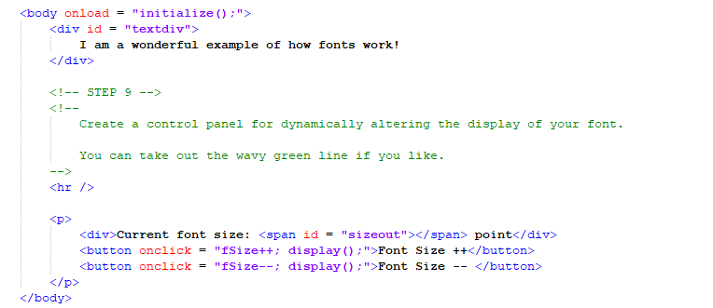
Construction

Slide 23
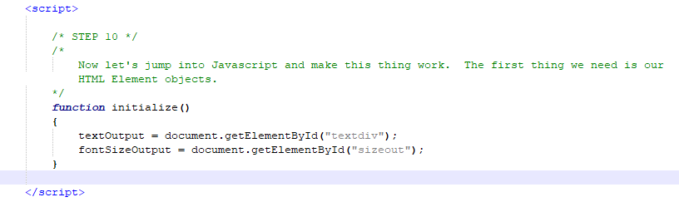
Construction

Slide 24
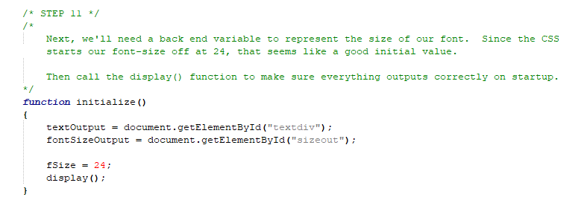
Construction

Slide 25
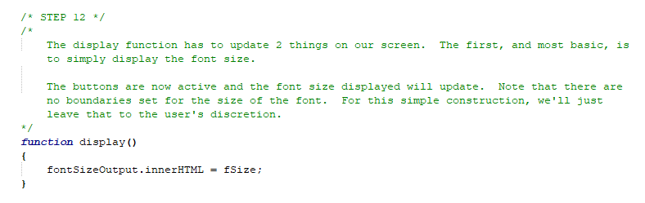
Construction

Slide 26
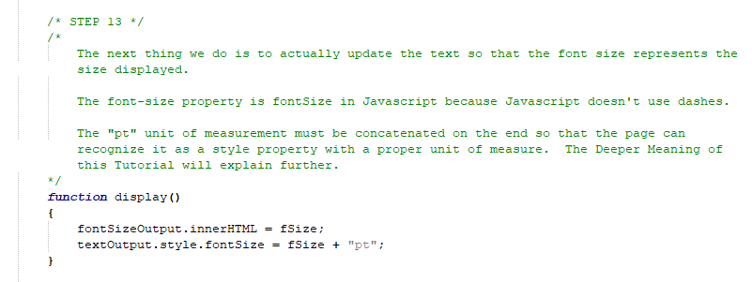
Construction

Slide 27
A DEEPER MEANING

Slide 28
A Deeper Meaning
I want to go back to talking about the distinction between back end and front end. CSS is a front end utility all the way. What it does is change the way elements look on screen. Anything that has to do with the display or the interface is considered front end.

Slide 29
A Deeper Meaning
When we use a button to change the value of, say, the font size (as we did in the construction), we can’t just adjust the property. The value of the property is something like “12pt”. Do you know what happens if you try to take “12pt” and add 1 to it? You get an error.

Slide 30
A Deeper Meaning
So I make this variable and I call it fSize, or something like that, and I give it the numeric value, like 12. Then, every time I want to adjust that number, I do the arithmetic on fSize. Then, when I’m ready to display, I reset the value of the font-size through the style property of the HTML element.

Slide 31
A Deeper Meaning
Like we did in the construction.

Slide 32
A Deeper Meaning
This is not the first time we’ve seen a dynamic alteration of the display. It’s a cornerstone of web programming and you should make every effort to understand this principle. Remember, every CSS property has an equivalent property as part of the style object. The values of each of those properties must be strings.

Slide 33
A Deeper Meaning
Programming is all about moving information. Once you understand enough to taking control of the information flow, you’ll be able to master your code.

Slide 34
FAQ

Slide 35
FAQ
When using CSS shorthand, does the order of the information count?
Yes. Some modern browsers are pretty good at figuring out stuff that’s out of order, but remember that the browser is parsing (interpreting) the string. If it’s going to do that properly, it needs to know which parts represent which pieces of information.

Slide 36
ACTIVITY

Slide 37
Children’s Story Revisited
Go back to the Children’s Story activity from Tutorial #2 and rework the CSS on the page. Try working with different fonts and font properties. Try using borders. Using the reference materials on w3shools.com, explore some of the CSS properties that haven’t been covered in these tutorials.

